Slide 1

Reconocimiento de Patrones
Domingo Mery
Departmento de Ciencia de la Computación
Escuela de Ingeniería
Universidad Católica de Chile
HoG - Human Detection
[ Capítulo 2 ]

Slide 2
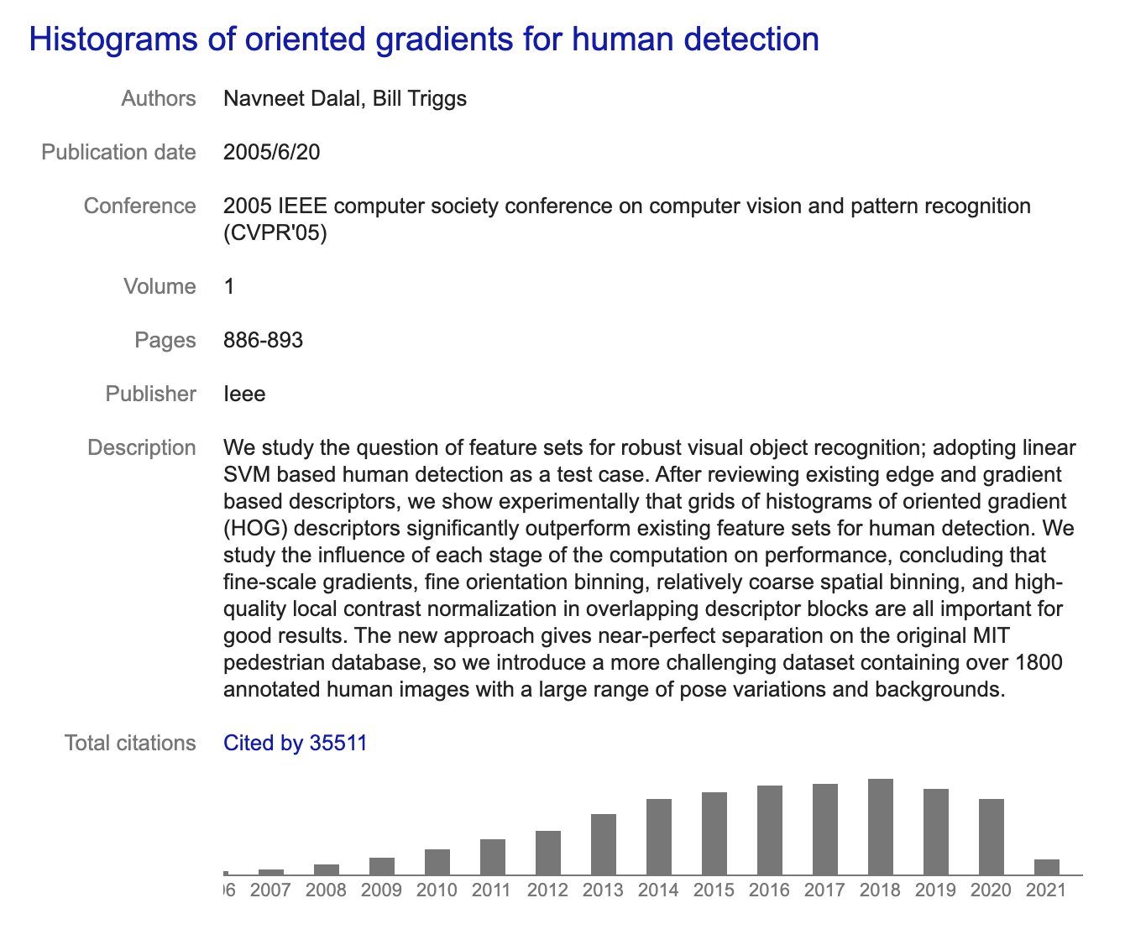

HoG: Histogram of oriented gradients
Navneet Dalal
N Dalal, B Triggs: Histograms of oriented gradients for human detection. Computer Vision and Pattern Recognition, (CVPR 2005).

Slide 3
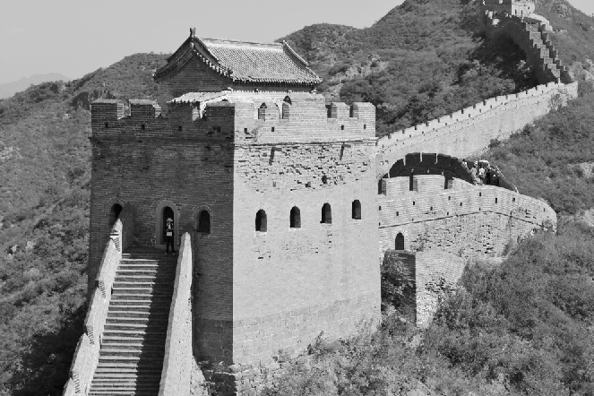
Histogram of Gradients
Gradient in x
direction
G_{x}
Gradient in y
direction
G_{y}

Slide 4
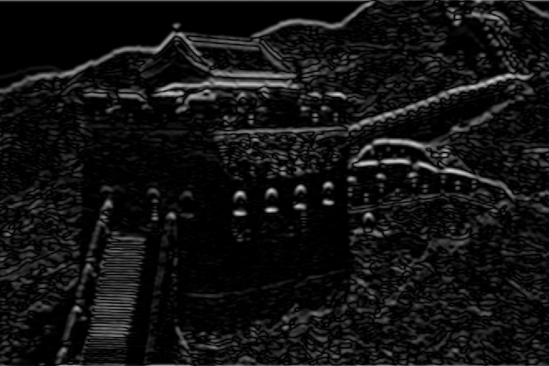
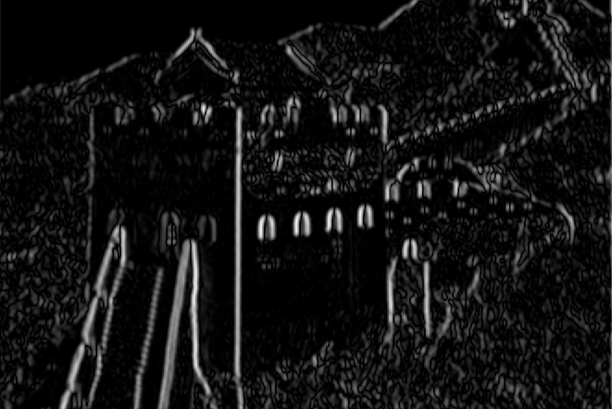
Histogram of Gradients
G_{x}: Gradient in x direction
Magnitude
R
= sqrt(G_{x}²+G_{y}²)
G_{y}: Gradient in y direction
Angle
A
= arctan(Gy/G_{x})

Slide 5
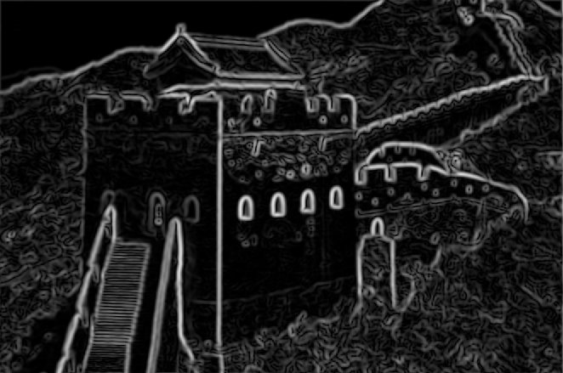
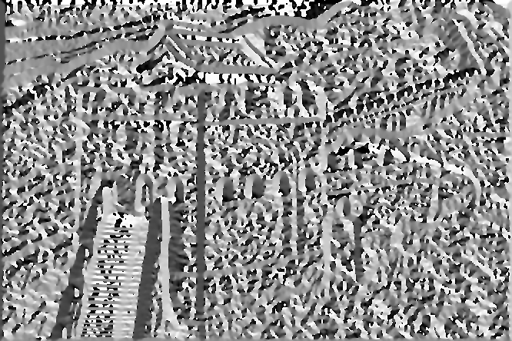
Histogram of Gradients
R: Magnitude
Histogram of 8 directions
3
4
2
A: Angle
5
1
6
8
7
1 2 3 4 5 6 7 8

Slide 6
Histogram of Gradients
R: Magnitude
Histogram of 8 directions
(computation of first bin)
3
4
2
A: Angle
5
1
6
8
7
1 2 3 4 5 6 7 8

Slide 7
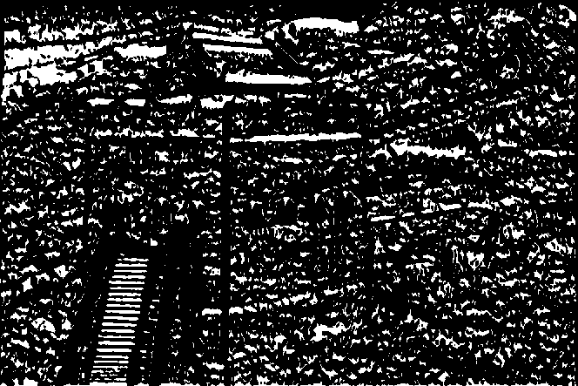
Histogram of Gradients
R: Magnitude
Histogram of 8 directions
(computation of first bin)
3
4
2
22.5º
A: Angle between -22.5º and 22.5º
5
1
-22.5º
6
8
7
1 2 3 4 5 6 7 8

Slide 8
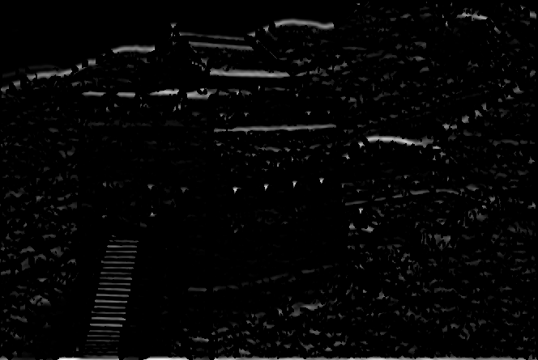
Histogram of Gradients
R: Magnitude in this direction
Histogram of 8 directions
(computation of first bin)
3
4
2
22.5º
A: Angle between -22.5º and 22.5º
5
1
Σ
-22.5º
6
8
7
1 2 3 4 5 6 7 8

Slide 9
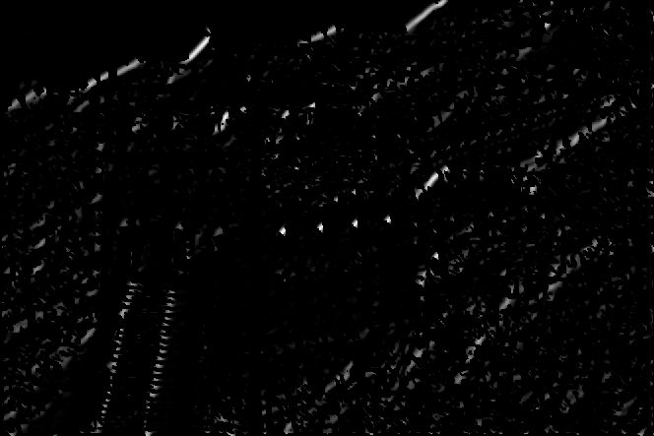
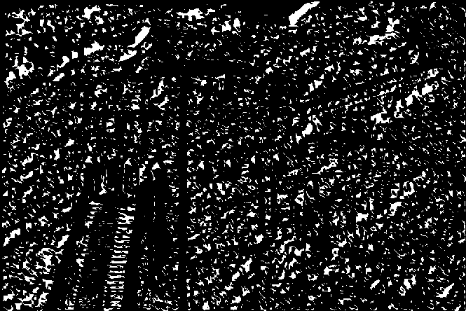
Histogram of Gradients
R: Magnitude in this direction
Histogram of 8 directions
(computation of second bin)
3
67.5º
4
2
22.5º
A: Angle between 22.5º and 67.5º
5
1
Σ
6
8
7
etc.
1 2 3 4 5 6 7 8

Slide 10
Histogram of Gradients
R: Magnitude
Histogram of 8 directions
3
4
2
A: Angle
5
1
6
8
7
1 2 3 4 5 6 7 8

Slide 11
Histogram of Gradients
R: Magnitude
Histogram of 8 directions
3
4
2
A: Angle
5
1
6
8
7
1 2 3 4 5 6 7 8

Slide 12
The descriptor proposed by the authors is a concatenation of HoG in different overlapped partitions

Slide 18
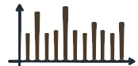
Feature
Extraction
. . .
Descriptor of n elements
n = # cells x # bins

Slide 19


Slide 20
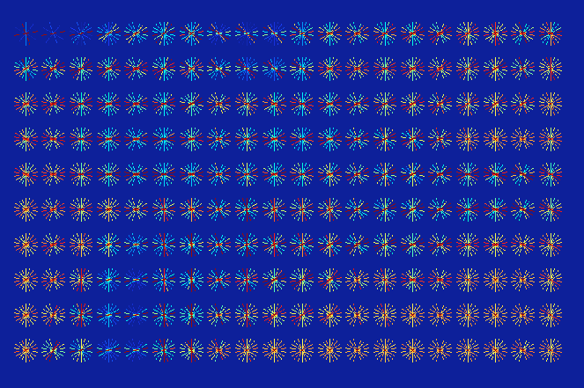

Slide 21
Example using Balu Library in Matlab:
options.nj = 20; % 10 x 20
options.ni = 10; % histograms
options.B = 9; % 9 bins
options.show = 1; % show results
I = imread('testimg1.jpg'); % input image
J = rgb2gray(I);
figure(1);imshow(J,[]);
figure(2);
[X,Xn] = Bfx_hog(J,options); % HOG features (see gradients
% arround perimeter).

Slide 22
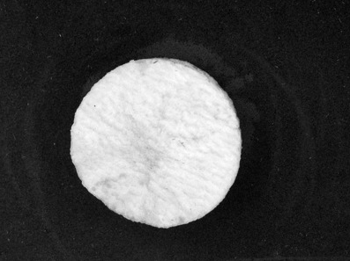
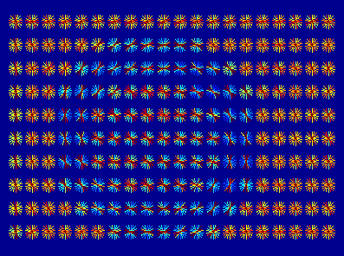
Example using Balu:

Slide 23
How to detect pedestrians using HoG?

Slide 24
The Solution

Slide 25
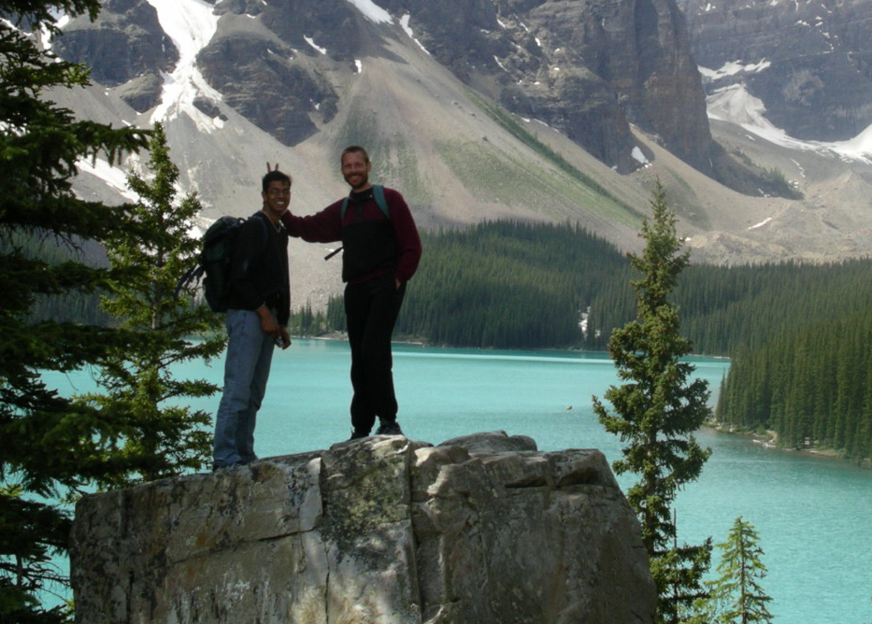
Strategy: Sliding Windows

Slide 26
Strategy: Sliding Windows

Slide 27
Strategy: Sliding Windows
Detection
Detection

Slide 28
The Key-Idea:
Design a classifier that is able to distinguish between
pedestrians from no-pedestrians.

Slide 29
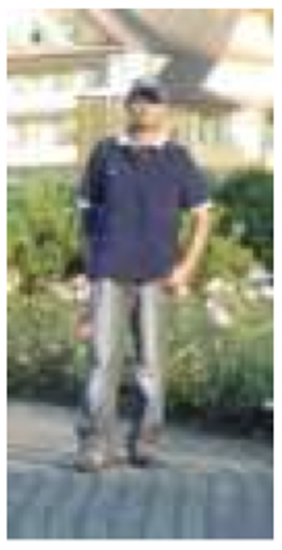
Positive Class: Pedestrians
Pedestrian

Slide 30
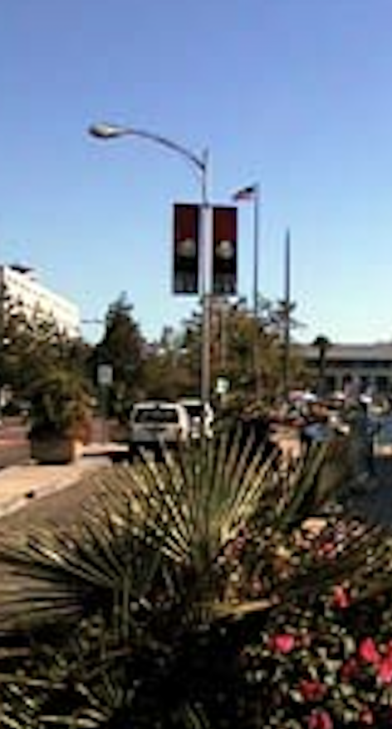
Negative Class: No-Pedestrians
No-Pedestrian

Slide 31
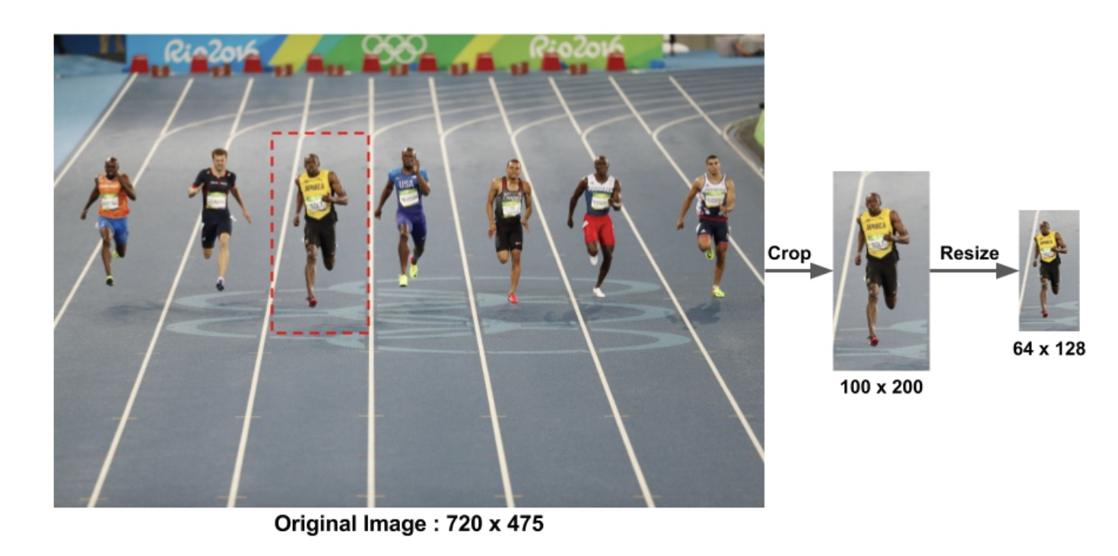
Construction of the Dataset: Positive Class

Slide 32
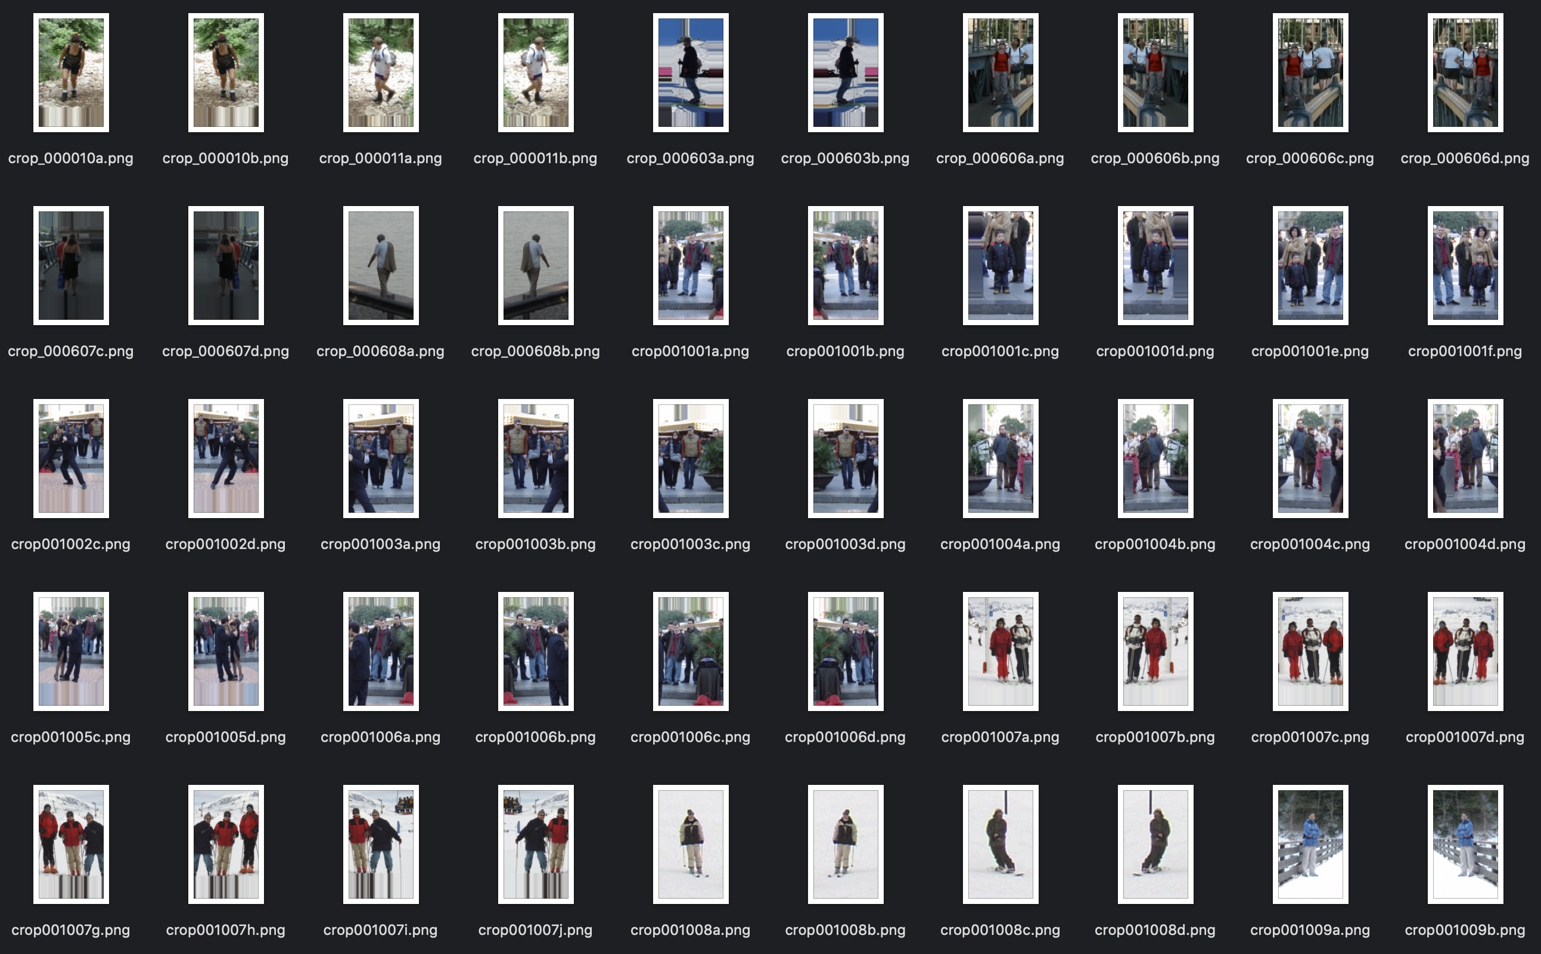
Positive Class: Pedestrians

Slide 33
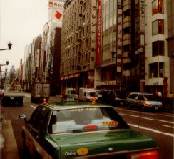
Construction of the Dataset: Negative Class

Slide 34
Construction of the Dataset: Negative Class

Slide 35
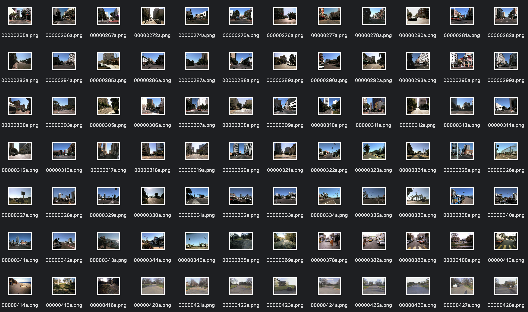
Negative Class: No-Pedestrians

Slide 36
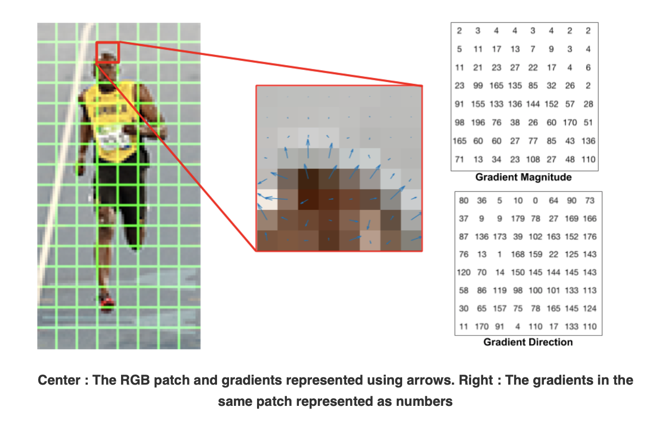
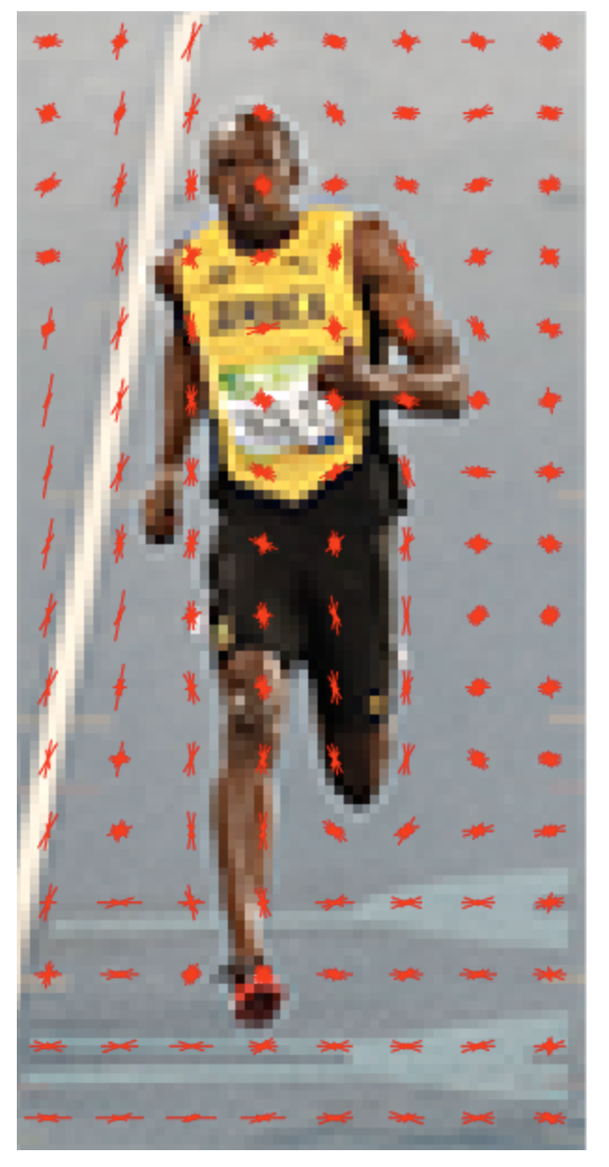
Image:
128 x 64 x 3 pixels
Feature Extraction
Descriptor
3780 elements
https://www.learnopencv.com/histogram-of-oriented-gradients/

Slide 37
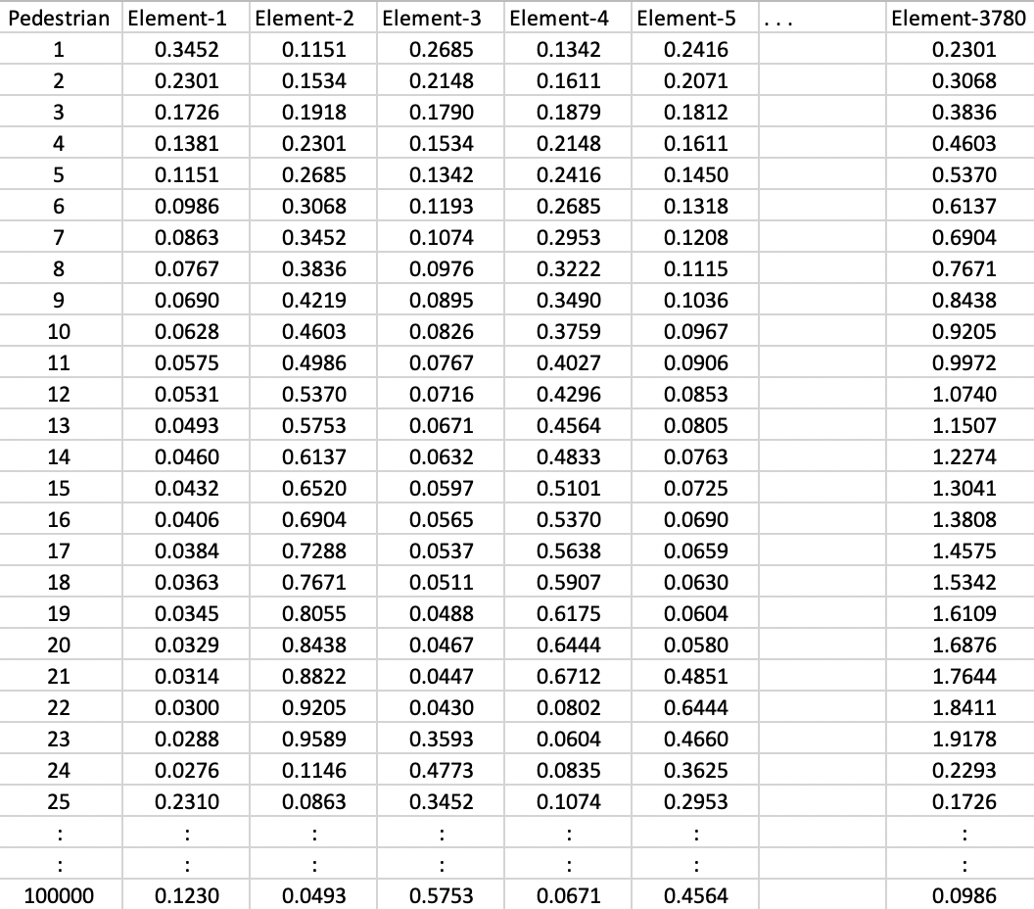
Dataset: Positive Class
Pedestrians

Slide 38
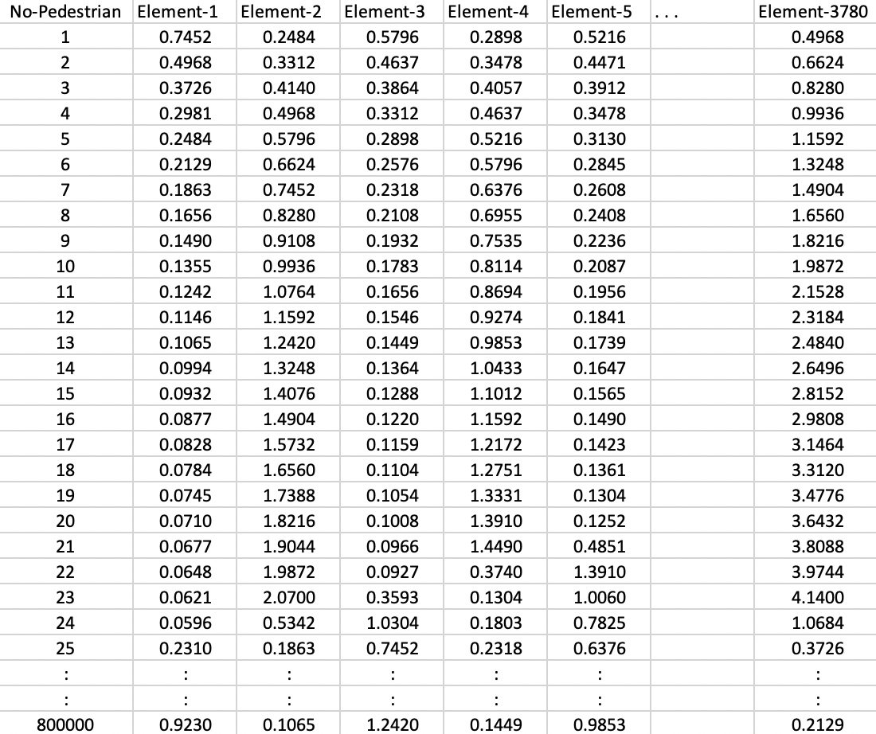
Dataset: Negative Class
No-
Pedestrians

Slide 39
Training
Pedestrians
Design of the
Classifier
Trained
Model
No-
Pedestrians
Dataset

Slide 40
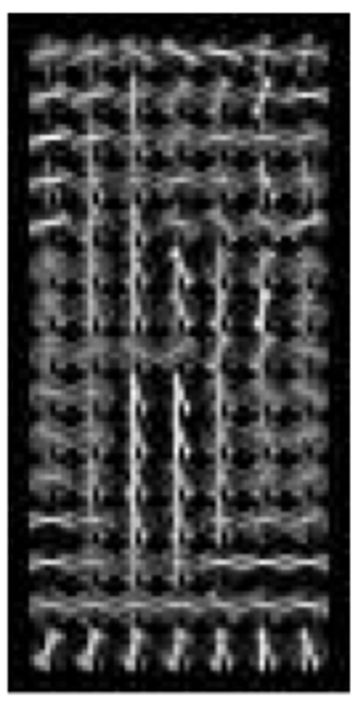
Image:
128 x 64 x 3 pixels
Descriptor
3780 elements
Output:
0 / 1
Pedestrian
Feature Extraction Classification
Using HoG Features Using Trained Model

Slide 41
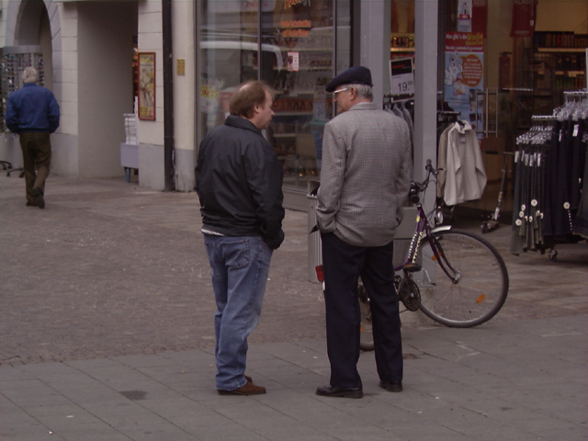
Example

Slide 42
Example

Slide 43
Example

Slide 44
Example

Slide 45
Detection
Example

Slide 46
Example

Slide 47
Detection
Detection
Example

Slide 48
Detection
Detection
Detection
Example

